Slide 1

Computer Organization
Programming Assignment 3

Slide 2
Outline
Introduction
Homework file structure
Test your answer
Score
Submission

Slide 3
Introduction
Implement cache replacement policy.
The goal is to find lowest cache miss rate.
You need to study spike cache simulator source code and modify it.
At least three policy(FIFO, LRU, LFU) you need to implement.
Bonus: you can implement your own arbitrary policy.

Slide 4
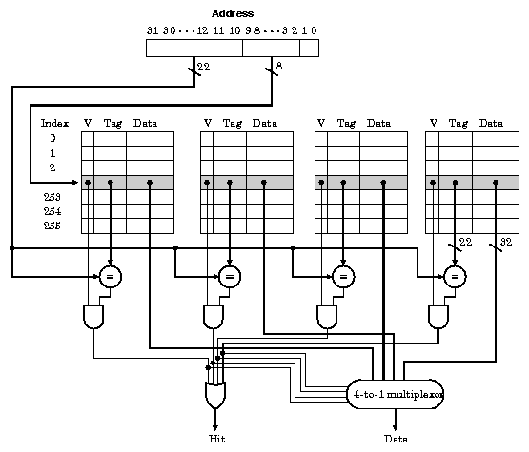
Introduction

Slide 5
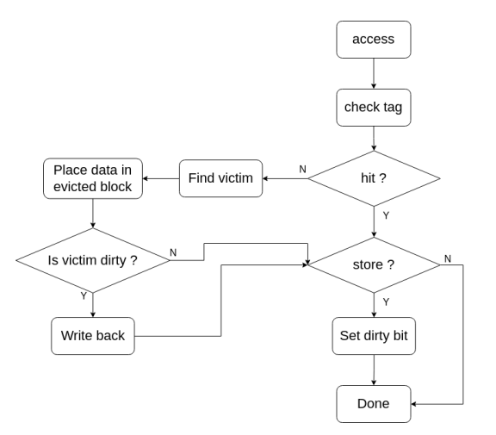
Introduction

Slide 6
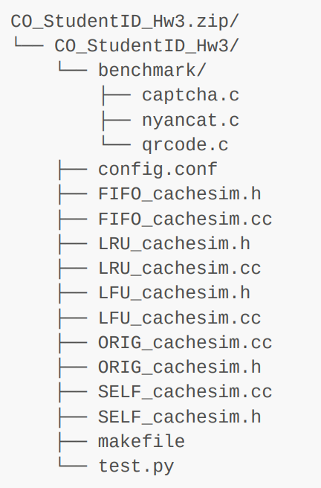
Homework file structure
benchmark: test data
config.conf: cache configuration with policy
XXX_cachesim.h: cache simulator header file
XXX_cachesim.cc: cache simulator source code
makefile: use to build and test program
Test.py: autotest file
Modify XXX_cachesim.h and XXX_cachesim.cc to implement cache replace policy.

Slide 7
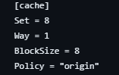
Test your answer
Set config.conf before you test your program
Set: cache set
Way: cache way
BlockSize: cache blocksize
Policy: can change to origin, fifo, lru, lfu, self
$ make origin
Build spike according to policy, origin can be changed to fifo, lru, lfu, self
$ make test
Auto run benchmark and get your miss rate
$ make score
Rebuild spike and auto run benchmark and get your miss rate

Slide 8
Score
Cache miss rate: 40%
Demo: 80%
Read document to get detail information

Slide 9
Submission
config.conf should set to best policy and cache setting.
Upload your homework to Moodle.
The expected arrangement of your codes:
Only .zip types of compression are allowed.
The directory should be organized as shown in document.
You will lose 10pt if your programs were uploaded in incorrect format!!!

Slide 10
Deadline
Postpone
30% off
Scoreless
5/11
Hw3 release
6/7
23:59 Deadline
6/14
23:59

Slide 11
How to Mail TAs
Send mail to asrlab@csie.ncku.edu.tw, not any TA’s mail!!
Email subject starts with “[Comp2023]”
Thoroughly read document before asking questions.

Slide 12
QUESTIONS ?

